Slide 1
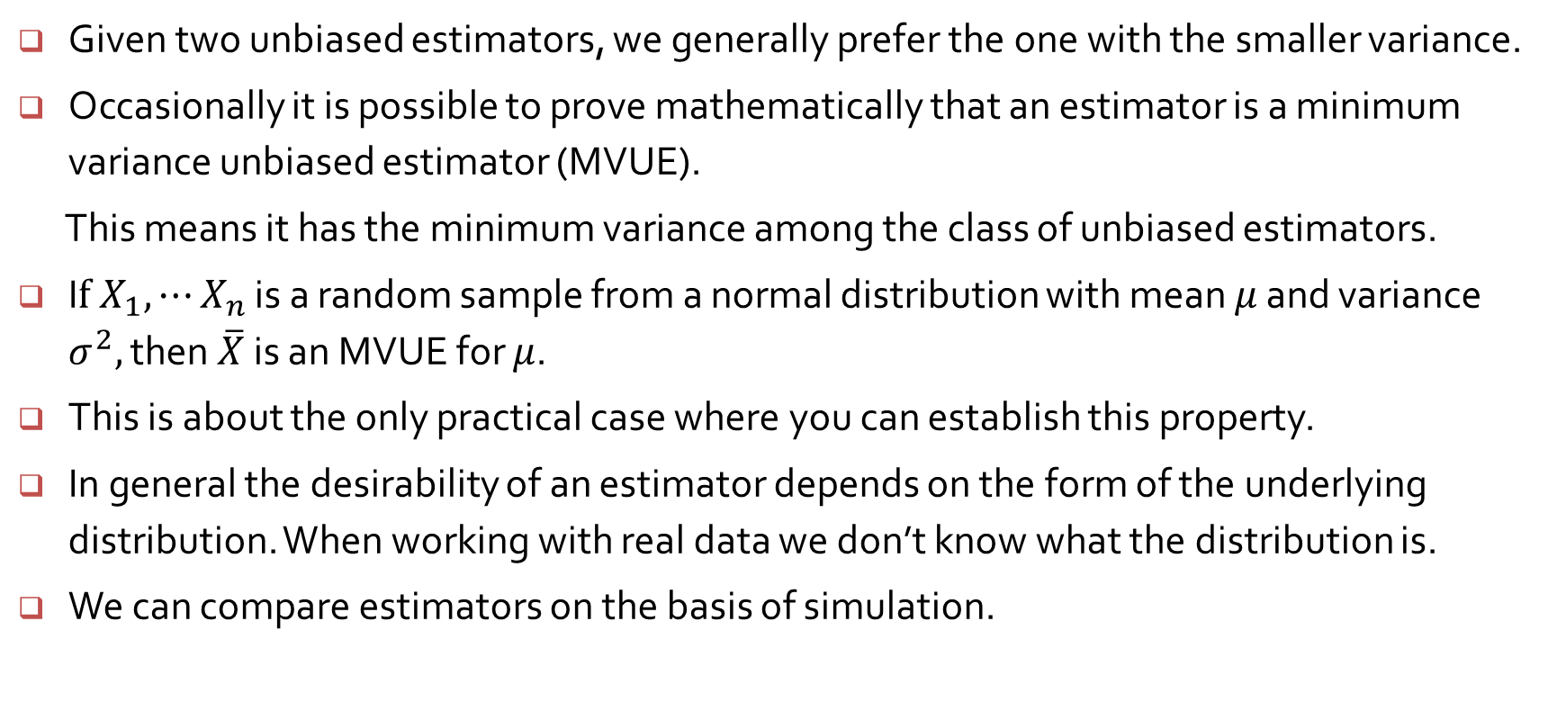
Variances of estimators
Given two unbiased estimators, we generally prefer the one with the smaller variance.
Occasionally it is possible to prove mathematically that an estimator is a minimum variance unbiased estimator (MVUE).
This means it has the minimum variance among the class of unbiased estimators.
I$f X_{1}, ⋯X_{n}$ is a random sample from a normal distribution with mean $μ$ and variance $σ^{2},$ then $\overline{X}$ is an MVUE for $μ$.
This is about the only practical case where you can establish this property.
In general the desirability of an estimator depends on the form of the underlying distribution. When working with real data we don’t know what the distribution is.
We can compare estimators on the basis of simulation.

Slide 2

Comparing estimators for the mean $μ,$normal distribution N(6, ${1.2}^{2})$
> k <- 50000
> n <- 25
> mns <- meds <- extravg <- trmns <- numeric(k)
> for (i in 1:k) {
+ samp <- rnorm(n, mean=6, sd=1.2)
+ mns[i] <- mean(samp)
+ meds[i] <- median(samp)
+ extravg[i] <- mean(range(samp))
+ trmns[i] <- mean(samp, trim=0.05)
+ }
> resultsN <- list(means = mns, medians = meds, extravg = extravg, trimmed = trmns)
> sapply(resultsN, mean)
means medians extravg trimmed
6.000328 6.001225 5.998205 6.000513
> sapply(resultsN, sd)
means medians extravg trimmed
0.2401946 0.2979679 0.4367173 0.2422739

Slide 3
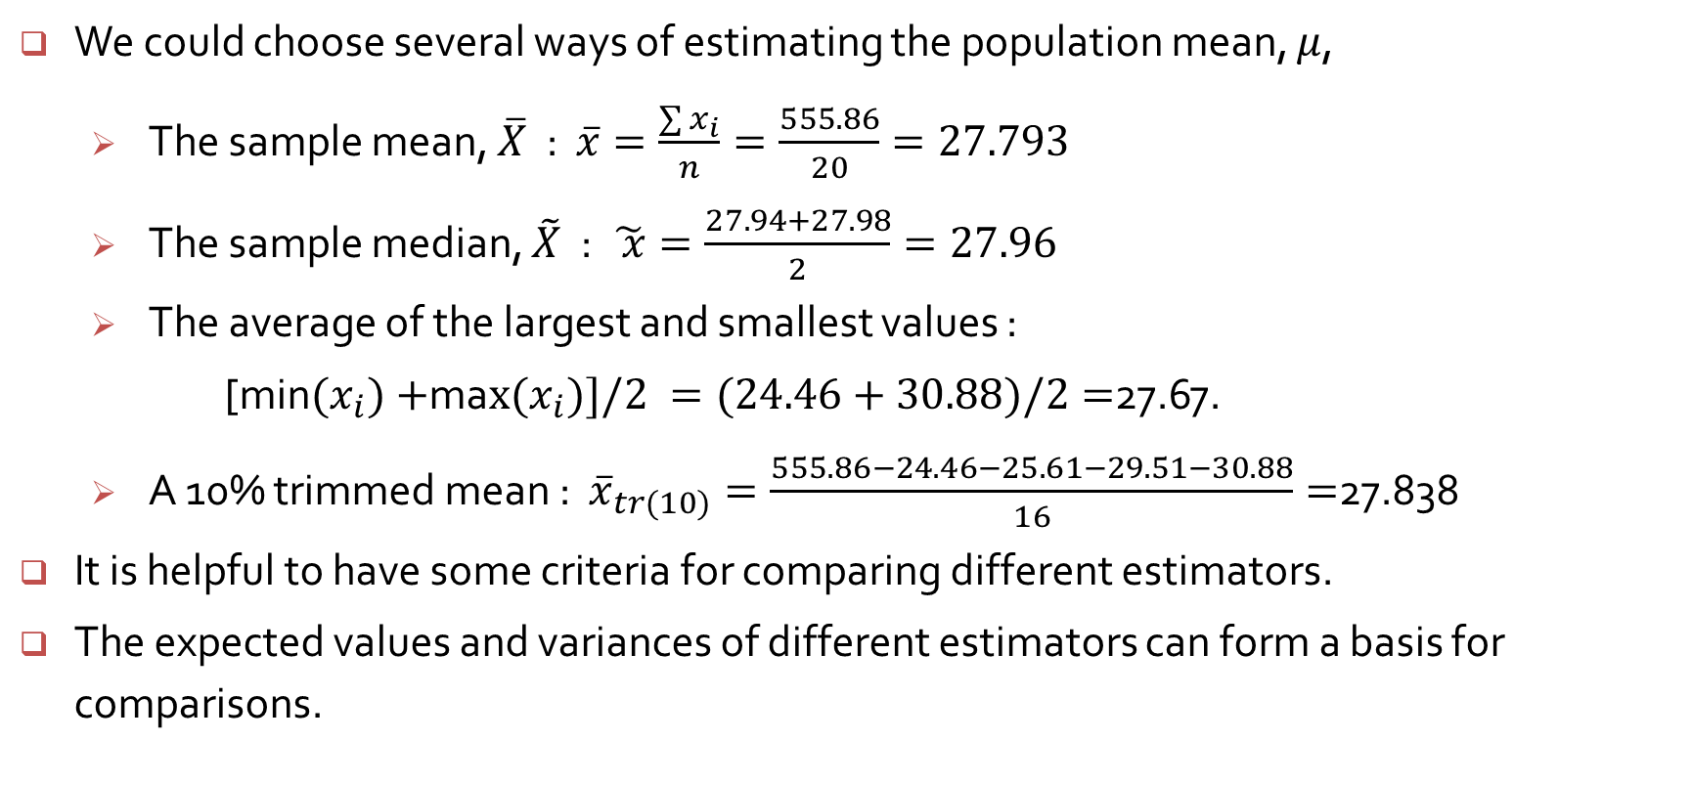
Example 6.2 (cont’d)
We could choose several ways of estimating the population mean, $μ$,
The sample mean, $\overline{X}$ : $\overline{x}=\frac{\sum{x_{i}}}{n}=\frac{555.86}{20}=27.793$
The sample median, $\tilde{X}$ : $\tilde{ x}=\frac{27.94+27.98}{2}=27.96$
The average of the largest and smallest values :
[min${(x}_{i})+$ma$x(x_{i})]/2 =(24.46+30.88)/2=$27.67.
A 10% trimmed mean : ${\overline{x}}_{tr(10)}=\frac{555.86−24.46−25.61−29.51−30.88}{16}=$27.838
It is helpful to have some criteria for comparing different estimators.
The expected values and variances of different estimators can form a basis for comparisons.

Slide 4
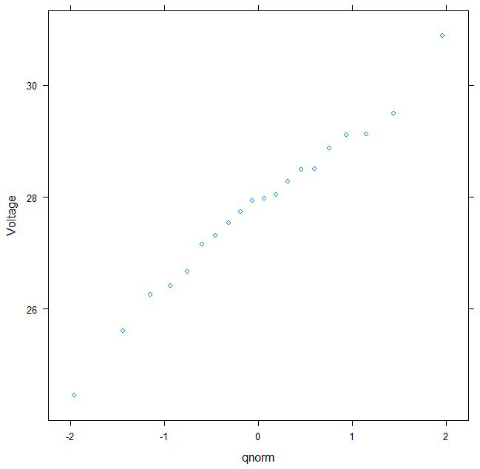
Example 6.2 : Dielectric breakdown voltage for epoxy resin
A normal probability plot shows that the data closely follow a normal shape
> str(xmp06.02)
> qqmath(~Voltage, xmp06.02)
> sort(xmp06.02$Voltage)
[1] 24.46 25.61 26.25 26.42 26.66 27.15 27.31 27.54 27.74 27.94 27.98 28.04
[13] 28.28 28.49 28.50 28.87 29.11 29.13 29.50 30.88

Slide 5
Comparing estimators for the location, Cauchy distribution
> for (i in 1:k) {
+ samp <- rcauchy(n, location=6, scale=1.2)
+ mns[i] <- mean(samp)
+ meds[i] <- median(samp)
+ extravg[i] <- mean(range(samp))
+ trmns[i] <- mean(samp, trim=0.05)
+ }
> resultsN <- list(means = mns, medians = meds, extravg = extravg, trimmed = trmns)
> sapply(resultsN, mean)
means medians extravg trimmed
5.671262 6.001956 1.846844 6.003820
> sapply(resultsN, sd)
means medians extravg trimmed
95.96416 0.40234 1198.19459 1.71752

Slide 6

Comparing estimators for the mean $μ, Uniform$distribution
> for (i in 1:k) {
+ samp <- runif(n, min=3, max=9)
+ mns[i] <- mean(samp)
+ meds[i] <- median(samp)
+ extravg[i] <- mean(range(samp))
+ trmns[i] <- mean(samp, trim=0.05)
+ }
> resultsN <- list(means = mns, medians = meds, extravg = extravg, trimmed = trmns)
> sapply(resultsN, mean)
means medians extravg trimmed
6.000695 6.001103 6.000357 6.000724
> sapply(resultsN, sd)
means medians extravg trimmed
0.34762 0.57853 0.16148 0.37156

Slide 7
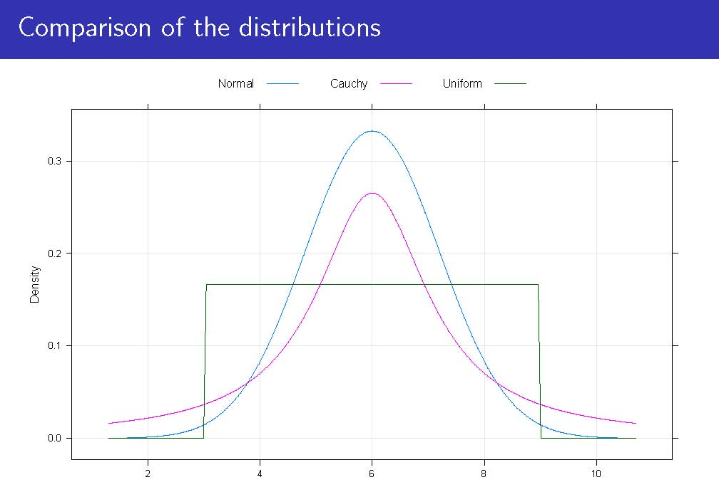

Slide 8
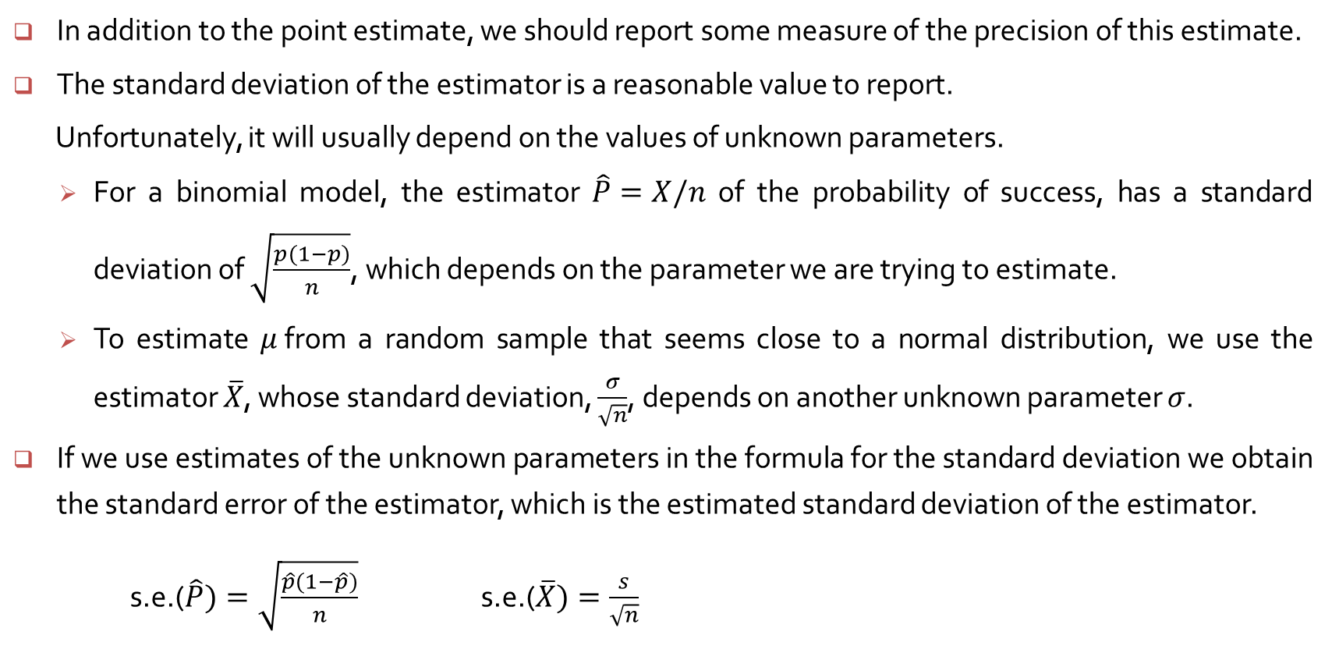
The standard error of an estimator
In addition to the point estimate, we should report some measure of the precision of this estimate.
The standard deviation of the estimator is a reasonable value to report.
Unfortunately, it will usually depend on the values of unknown parameters.
For a binomial model, the estimator $\hat{P}=X/n$ of the probability of success, has a standard deviation of $\sqrt{\frac{p(1−p)}{n}}$, which depends on the parameter we are trying to estimate.
To estimate $μ$from a random sample that seems close to a normal distribution, we use the estimator $\overline{X}$, whose standard deviation, $\frac{σ}{\sqrt{n}}$, depends on another unknown parameter $σ$.
If we use estimates of the unknown parameters in the formula for the standard deviation we obtain the standard error of the estimator, which is the estimated standard deviation of the estimator.
s.e.($\hat{P})=\sqrt{\frac{\hat{p}(1−\hat{p})}{n}}$ s.e.($\overline{X})=\frac{s}{\sqrt{n}}$

Slide 9
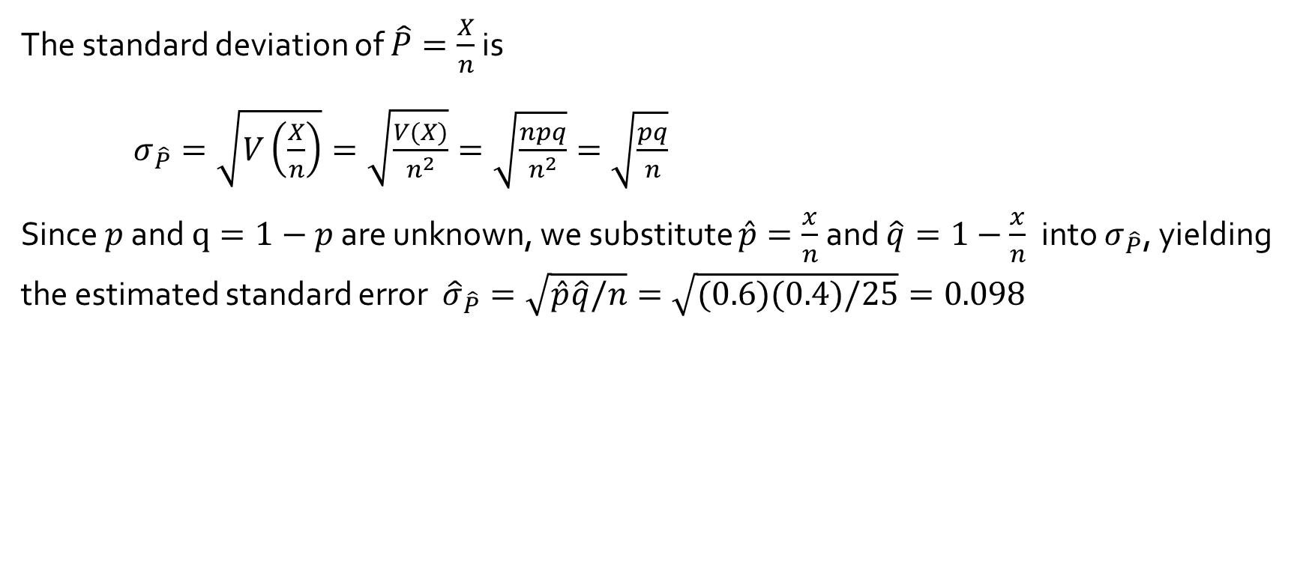
Example 6.10
The standard deviation of $\hat{P}=\frac{X}{n}$ is
$σ_{\hat{P}}=\sqrt{V\left(\frac{X}{n}\right)}=\sqrt{\frac{V(X)}{n^{2}}}=\sqrt{\frac{npq}{n^{2}}}=\sqrt{\frac{pq}{n}}$
Since $p$ and $q=1−p$ are unknown, we substitute $\hat{p}=\frac{x}{n}$ and $\hat{q}=1−\frac{x}{n}$ into $σ_{\hat{P}}$, yielding the estimated standard error ${\hat{σ}}_{\hat{P}}=\sqrt{\hat{p}\hat{q}/n}=\sqrt{(0.6)(0.4)/25}=0.098$

Slide 10
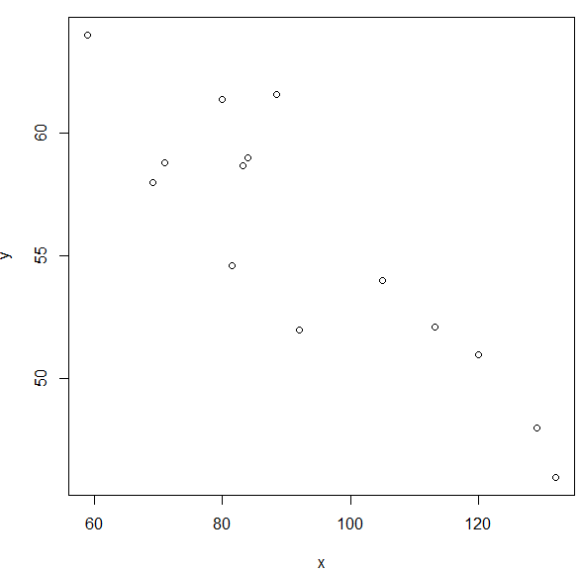
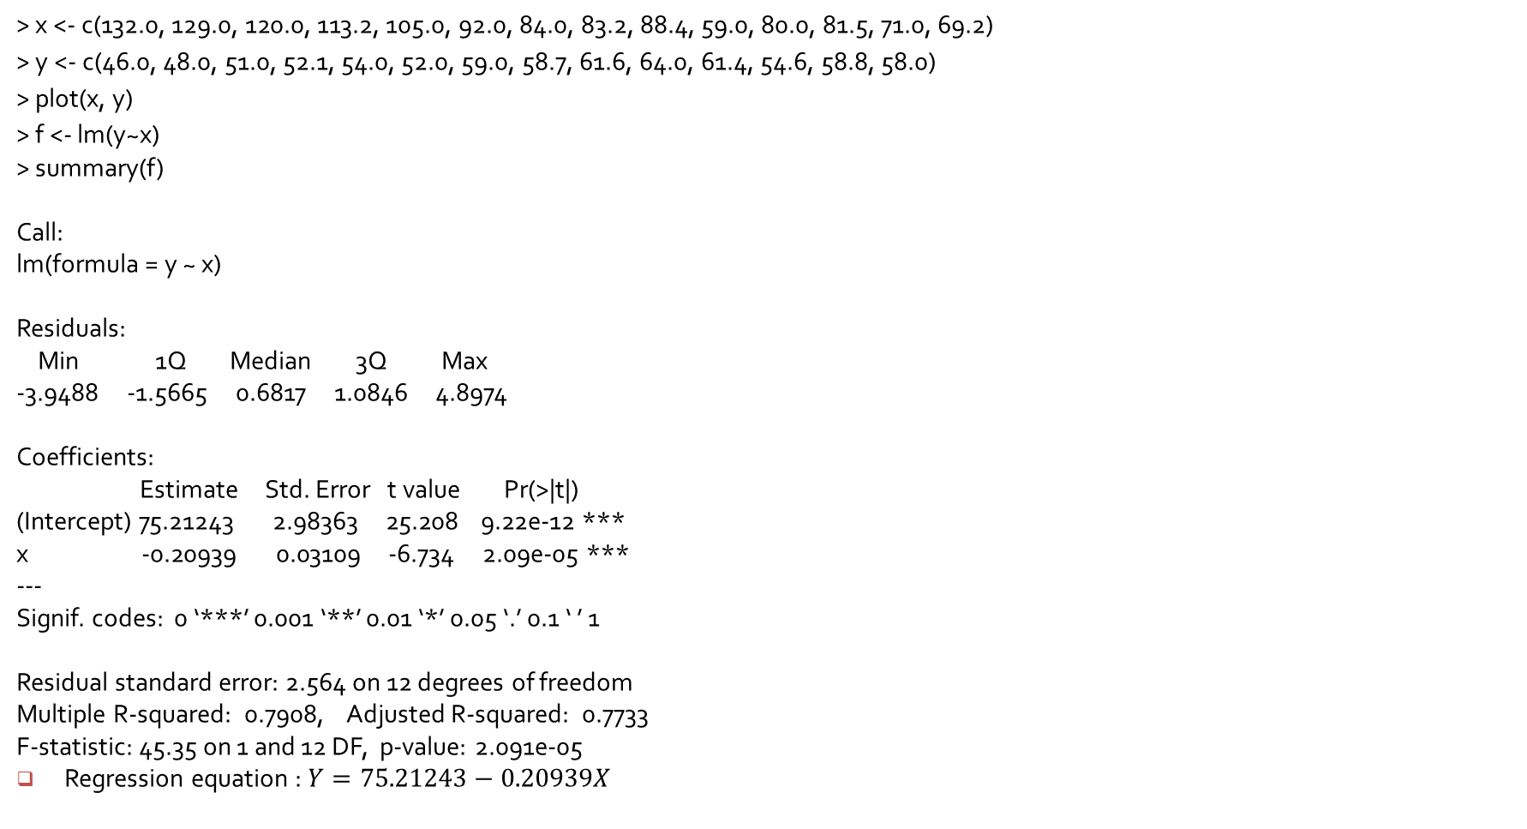
> x <- c(132.0, 129.0, 120.0, 113.2, 105.0, 92.0, 84.0, 83.2, 88.4, 59.0, 80.0, 81.5, 71.0, 69.2)
> y <- c(46.0, 48.0, 51.0, 52.1, 54.0, 52.0, 59.0, 58.7, 61.6, 64.0, 61.4, 54.6, 58.8, 58.0)
> plot(x, y)
> f <- lm(y~x)
> summary(f)
Call:
lm(formula = y ~ x)
Residuals:
Min 1Q Median 3Q Max
-3.9488 -1.5665 0.6817 1.0846 4.8974
Coefficients:
Estimate Std. Error t value Pr(>|t|)
(Intercept) 75.21243 2.98363 25.208 9.22e-12 ***
x -0.20939 0.03109 -6.734 2.09e-05 ***
---
Signif. codes: 0 ‘***’ 0.001 ‘**’ 0.01 ‘*’ 0.05 ‘.’ 0.1 ‘ ’ 1
Residual standard error: 2.564 on 12 degrees of freedom
Multiple R-squared: 0.7908, Adjusted R-squared: 0.7733
F-statistic: 45.35 on 1 and 12 DF, p-value: 2.091e-05
Regression equation : $Y=75.21243−0.20939X$

